Slide 1
Rails Form Helpers

Slide 2
Why use Form Helpers?
Forms in web applications are an essential interface for user input.
Form markup can quickly become tedious to write and maintain because of the need to handle form control naming and its numerous attributes
In forms, helpers are methods Rails provides that help us to quickly generate HTML markup.

Slide 3
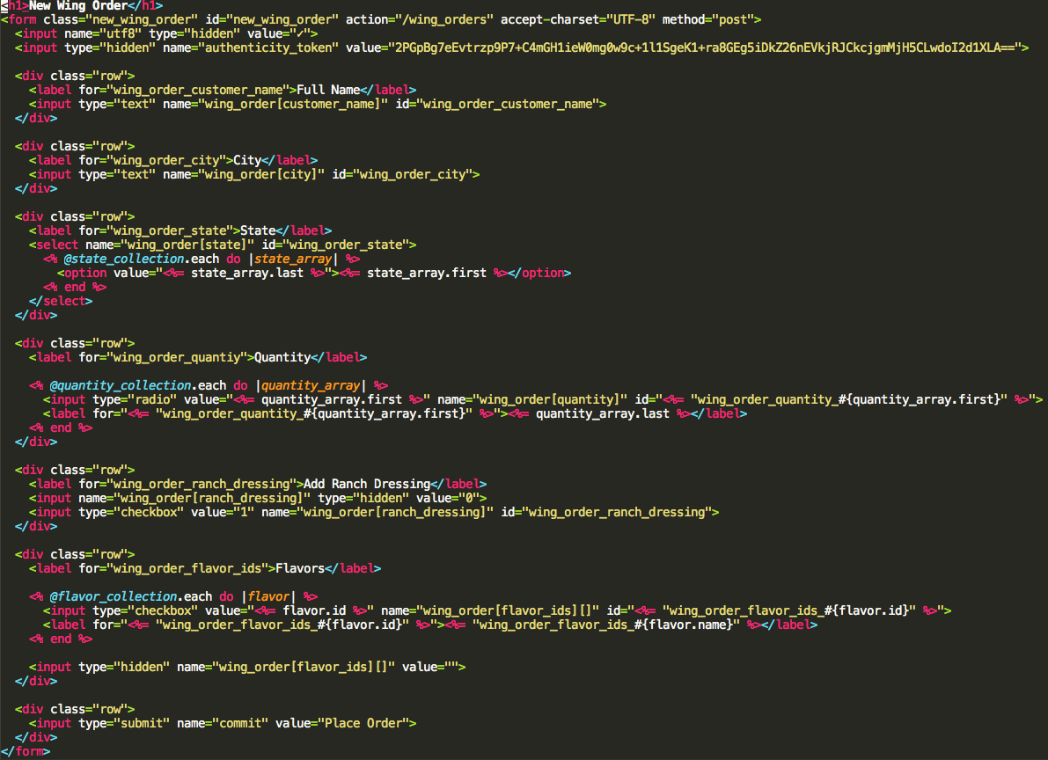

Slide 4
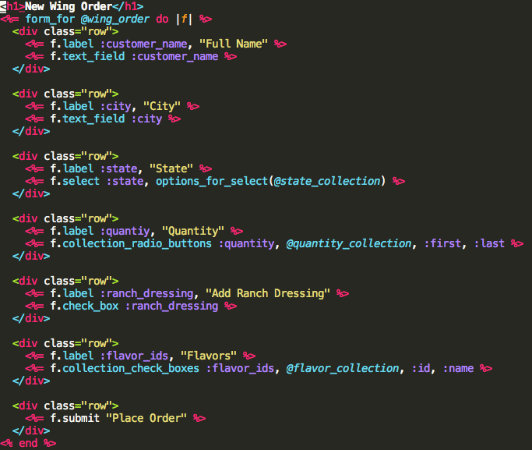

Slide 5
Generic Form
<form action="/search" method="get">
<input name="query" type="text" />
<input type="submit" value="Search" />
</form>

Slide 6
Generic Form
<form action="/search" method="get">
<input name="query" type="text" />
<input type="submit" value="Search" />
</form>
<%= form_tag("/search", method: "get") do %>
<%= text_field_tag(:query) %>
<%= submit_tag("Search") %>
<% end %>
The form_tag helper accepts 2 arguments: the path for the action and an options hash.

Slide 7
Binding an object to a form
class NominationsController < ApplicationController
def new
@nomination = Nomination.new
@nominee_options = [[“test user”, 10]]
end
end

Slide 8
Binding an object to a form
class NominationsController < ApplicationController
def new
@nomination = Nomination.new
@nominee_options = [[“test user”, 10]]
end
end
# nominations/new.html.erb
<%= form_for @nomination do |f| %>
<%= f.select :nominee_id, options_for_select(@nominee_options) %>
<%= f.text_field :body, placeholder: Nomination::PLACEHOLDERS.sample %>
<%= f.submit "Submit", class: "button-hollow-white expand small" %>
<% end %>
Identifies the object

Slide 9
Binding an object to a form
class NominationsController < ApplicationController
def new
@nomination = Nomination.new
@nominee_options = [[“test user”, 10]]
end
end
# nominations/new.html.erb
<%= form_for @nomination do |f| %>
<%= f.select :nominee_id, options_for_select(@nominee_options) %>
<%= f.text_field :body, placeholder: Nomination::PLACEHOLDERS.sample %>
<%= f.submit "Submit", class: "button-hollow-white expand small" %>
<% end %>
F represents the current form object

Slide 10
Binding an object to a form
class NominationsController < ApplicationController
def new
@nomination = Nomination.new
@nominee_options = [[“test user”, 10]]
end
end
# nominations/new.html.erb
<%= form_for @nomination do |f| %>
<%= f.select :nominee_id, options_for_select(@nominee_options) %>
<%= f.text_field :body, placeholder: Nomination::PLACEHOLDERS.sample %>
<%= f.submit "Submit", class: "button-hollow-white expand small" %>
<% end %>
We can invoke instance methods on this object to build labels, text fields, textareas, and other inputs:

Slide 11
Binding an object to a form
class NominationsController < ApplicationController
def new
@nomination = Nomination.new
@nominee_options = [[“test user”, 10]]
end
end
# nominations/new.html.erb
<%= form_for @nomination do |f| %>
<%= f.select :nominee_id, options_for_select(@nominee_options) %>
<%= f.text_field :body, placeholder: Nomination::PLACEHOLDERS.sample %>
<%= f.submit "Submit", class: "button-hollow-white expand small" %>
<% end %>
Identifies the object
attributes

Slide 12
Binding an object to a form
class NominationsController < ApplicationController
def new
@nomination = Nomination.new
@nominee_options = [[“test user”, 10]]
end
end
# nominations/new.html.erb
<%= form_for @nomination do |f| %>
<%= f.select :nominee_id, options_for_select(@nominee_options) %>
<%= f.text_field :body, placeholder: Nomination::PLACEHOLDERS.sample %>
<%= f.submit "Submit", class: "button-hollow-white expand small" %>
<% end %>
Nomination with no attributes
Identifies the object
attributes

Slide 13
Binding an object to a form
class NominationsController < ApplicationController
def new
@nomination = Nomination.new
@nominee_options = [[“test user”, 10]]
end
end
# nominations/new.html.erb
<%= form_for @nomination do |f| %>
<%= f.select :nominee_id, options_for_select(@nominee_options) %>
<%= f.text_field :body, placeholder: Nomination::PLACEHOLDERS.sample %>
<%= f.submit "Submit", class: "button-hollow-white expand small" %>
<% end %>
Nomination with no attributes
Identifies the object
attributes
Collection of options (array) - use if you want options for select

Slide 14
Binding an object to a form
# nominations/new.html.erb
<%= form_for @nomination do |f| %>
<%= f.select :nominee_id, options_for_select(@nominee_options) %>
<%= f.text_field :body, placeholder: Nomination::PLACEHOLDERS.sample %>
<%= f.submit "Submit", class: "button-hollow-white expand small" %>
<% end %>
Form becomes the HTML we used to write
<form class="nomination-form" id="new_nomination" action="/nominations" accept-charset="UTF-8" method="post">
<input name="utf8" type="hidden" value="✓">
<input type="hidden" name="authenticity_token"
value="shoSRAF0xUkANb1JapRh1cICzAamWxtjHF9W+XHmw13yWdE1z5cnhhH4Ph88g89O12earv4PqouPkQJpLPpSjg==">
<select name="nomination[nominee_id]" id="nomination_nominee_id">
<option value="10">test user</option>
</select>
<input placeholder="Best spectacles" type="text" name="nomination[body]" id="nomination_body">
<input type="submit" name="commit" value="Submit" class="button-hollow-white expand small">
</form>

Slide 15
Binding an object to a form
# nominations/new.html.erb
<%= form_for @nomination do |f| %>
<%= f.select :nominee_id, options_for_select(@nominee_options) %>
<%= f.text_field :body, placeholder: Nomination::PLACEHOLDERS.sample %>
<%= f.submit "Submit", class: "button-hollow-white expand small" %>
<% end %>
<form class="nomination-form" id="new_nomination" action="/nominations" accept-charset="UTF-8" method="post">
<input name="utf8" type="hidden" value="✓">
<input type="hidden" name="authenticity_token"
value="shoSRAF0xUkANb1JapRh1cICzAamWxtjHF9W+XHmw13yWdE1z5cnhhH4Ph88g89O12earv4PqouPkQJpLPpSjg==">
<select name="nomination[nominee_id]" id="nomination_nominee_id">
<option value="10">test user</option>
</select>
<input placeholder="Best spectacles" type="text" name="nomination[body]" id="nomination_body">
<input type="submit" name="commit" value="Submit" class="button-hollow-white expand small">
</form>

Slide 16
Binding an object to a form
# nominations/new.html.erb
<%= form_for @nomination do |f| %>
<%= f.select :nominee_id, options_for_select(@nominee_options) %>
<%= f.text_field :body, placeholder: Nomination::PLACEHOLDERS.sample %>
<%= f.submit "Submit", class: "button-hollow-white expand small" %>
<% end %>
<form class="nomination-form" id="new_nomination" action="/nominations" accept-charset="UTF-8" method="post">
<input name="utf8" type="hidden" value="✓">
<input type="hidden" name="authenticity_token"
value="shoSRAF0xUkANb1JapRh1cICzAamWxtjHF9W+XHmw13yWdE1z5cnhhH4Ph88g89O12earv4PqouPkQJpLPpSjg==">
<select name="nomination[nominee_id]" id="nomination_nominee_id">
<option value="10">test user</option>
</select>
<input placeholder="Best spectacles" type="text" name="nomination[body]" id="nomination_body">
<input type="submit" name="commit" value="Submit" class="button-hollow-white expand small">
</form>

Slide 17
Binding an object to a form
# nominations/new.html.erb
<%= form_for @nomination do |f| %>
<%= f.select :nominee_id, options_for_select(@nominee_options) %>
<%= f.text_field :body, placeholder: Nomination::PLACEHOLDERS.sample %>
<%= f.submit "Submit", class: "button-hollow-white expand small" %>
<% end %>
<form class="nomination-form" id="new_nomination" action="/nominations" accept-charset="UTF-8" method="post">
<input name="utf8" type="hidden" value="✓">
<input type="hidden" name="authenticity_token"
value="shoSRAF0xUkANb1JapRh1cICzAamWxtjHF9W+XHmw13yWdE1z5cnhhH4Ph88g89O12earv4PqouPkQJpLPpSjg==">
<select name="nomination[nominee_id]" id="nomination_nominee_id">
<option value="10">test user</option>
</select>
<input placeholder="Best spectacles" type="text" name="nomination[body]" id="nomination_body">
<input type="submit" name="commit" value="Submit" class="button-hollow-white expand small">
</form>

Slide 18
Binding an object to a form
# nominations/new.html.erb
<%= form_for @nomination do |f| %>
<%= f.select :nominee_id, options_for_select(@nominee_options) %>
<%= f.text_field :body, placeholder: Nomination::PLACEHOLDERS.sample %>
<%= f.submit "Submit", class: "button-hollow-white expand small" %>
<% end %>
<form class="nomination-form" id="new_nomination" action="/nominations" accept-charset="UTF-8" method="post">
<input name="utf8" type="hidden" value="✓">
<input type="hidden" name="authenticity_token"
value="shoSRAF0xUkANb1JapRh1cICzAamWxtjHF9W+XHmw13yWdE1z5cnhhH4Ph88g89O12earv4PqouPkQJpLPpSjg==">
<select name="nomination[nominee_id]" id="nomination_nominee_id">
<option value="10">test user</option>
</select>
<input placeholder="Best spectacles" type="text" name="nomination[body]" id="nomination_body">
<input type="submit" name="commit" value="Submit" class="button-hollow-white expand small">
</form>

Slide 19
Digging Into Forms
<form class="nomination-form" id="new_nomination" action="/nominations" accept-charset="UTF-8" method="post">
<input name="utf8" type="hidden" value="✓">
<input type="hidden" name="authenticity_token" value="shoSRAF0xUkANb1JapRh1cICzAamWxtjHF9W+XHmw13yWdE1z5cnhhH4Ph88g89O12earv4PqouPkQJpLPpSjg==">
<select name="nomination[nominee_id]" id="nomination_nominee_id">
<option value="10">test user</option>
</select>
<input placeholder="Best spectacles" type="text" name="nomination[body]" id="nomination_body">
<input type="submit" name="commit" value="Submit" class="button-hollow-white expand small">
</form>

Slide 20
Digging Into Forms
<form class="nomination-form" id="new_nomination" action="/nominations" accept-charset="UTF-8" method="post">
<input name="utf8" type="hidden" value="✓">
<input type="hidden" name="authenticity_token" value="shoSRAF0xUkANb1JapRh1cICzAamWxtjHF9W+XHmw13yWdE1z5cnhhH4Ph88g89O12earv4PqouPkQJpLPpSjg==">
<select name="nomination[nominee_id]" id="nomination_nominee_id">
<option value="10">test user</option>
</select>
<input placeholder="Best spectacles" type="text" name="nomination[body]" id="nomination_body">
<input type="submit" name="commit" value="Submit" class="button-hollow-white expand small">
</form>
Specifies url and HTTP method.

Slide 21
Digging Into Forms
<form class="nomination-form" id="new_nomination" action="/nominations" accept-charset="UTF-8" method="post">
<input name="utf8" type="hidden" value="✓">
<input type="hidden" name="authenticity_token" value="shoSRAF0xUkANb1JapRh1cICzAamWxtjHF9W+XHmw13yWdE1z5cnhhH4Ph88g89O12earv4PqouPkQJpLPpSjg==">
<select name="nomination[nominee_id]" id="nomination_nominee_id">
<option value="10">test user</option>
</select>
<input placeholder="Best spectacles" type="text" name="nomination[body]" id="nomination_body">
<input type="submit" name="commit" value="Submit" class="button-hollow-white expand small">
</form>
Specifies url and HTTP method.
Sets character encoding to utf8.

Slide 22
Digging Into Forms
<form class="nomination-form" id="new_nomination" action="/nominations" accept-charset="UTF-8" method="post">
<input name="utf8" type="hidden" value="✓">
<input type="hidden" name="authenticity_token" value="shoSRAF0xUkANb1JapRh1cICzAamWxtjHF9W+XHmw13yWdE1z5cnhhH4Ph88g89O12earv4PqouPkQJpLPpSjg==">
<select name="nomination[nominee_id]" id="nomination_nominee_id">
<option value="10">test user</option>
</select>
<input placeholder="Best spectacles" type="text" name="nomination[body]" id="nomination_body">
<input type="submit" name="commit" value="Submit" class="button-hollow-white expand small">
</form>
Specifies url and HTTP method.
Sets character encoding to utf8.
Sets authenticity_token to prevent Cross-Site Request Forgery (CSRF).

Slide 23
Digging Into Forms
<form class="nomination-form" id="new_nomination" action="/nominations" accept-charset="UTF-8" method="post">
<input name="utf8" type="hidden" value="✓">
<input type="hidden" name="authenticity_token" value="shoSRAF0xUkANb1JapRh1cICzAamWxtjHF9W+XHmw13yWdE1z5cnhhH4Ph88g89O12earv4PqouPkQJpLPpSjg==">
<select name="nomination[nominee_id]" id="nomination_nominee_id">
<option value="10">test user</option>
</select>
<input placeholder="Best spectacles" type="text" name="nomination[body]" id="nomination_body">
<input type="submit" name="commit" value="Submit" class="button-hollow-white expand small">
</form>
Specifies url and HTTP method.
Sets character encoding to utf8.
Sets authenticity_token to prevent Cross-Site Request Forgery (CSRF).
Formats params hash in preparation for strong parameters on server side.
{ “utf8” => “✓”, “authenticity_token” => “shoSRAF0...”, }

Slide 24
Digging Into Forms
<form class="nomination-form" id="new_nomination" action="/nominations" accept-charset="UTF-8" method="post">
<input name="utf8" type="hidden" value="✓">
<input type="hidden" name="authenticity_token" value="shoSRAF0xUkANb1JapRh1cICzAamWxtjHF9W+XHmw13yWdE1z5cnhhH4Ph88g89O12earv4PqouPkQJpLPpSjg==">
<select name="nomination[nominee_id]" id="nomination_nominee_id">
<option value="10">test user</option>
</select>
<input placeholder="Best spectacles" type="text" name="nomination[body]" id="nomination_body">
<input type="submit" name="commit" value="Submit" class="button-hollow-white expand small">
</form>
Specifies url and HTTP method.
Sets character encoding to utf8.
Sets authenticity_token to prevent Cross-Site Request Forgery (CSRF).
Formats params hash in preparation for strong parameters on server side.
{ “utf8” => “✓”, “authenticity_token” => “shoSRAF0...”, “nomination” => { “nominee_id => “10”, “body” => “Best facilitation presenter” } }

Slide 25
Strong Parameters
# params
{ “utf8” => “✓”, “authenticity_token” => “shoSRAF0...”, “nomination” => { “nominee_id” => “10”, “body” => “Best facilitation presenter”,
“vote_count” => “1000” } }
What if someone tried to edit something you don’t want edited?

Slide 26
Strong Parameters
# params
{ “utf8” => “✓”, “authenticity_token” => “shoSRAF0...”, “nomination” => { “nominee_id” => “10”, “body” => “Best facilitation presenter”,
“vote_count” => “1000” } }
# params.require(:nomination)
{
“nominee_id” => “10”,
“body” => “Best facilitation presenter”,
“vote_count” => “1000”
}
Focus on that key

Slide 27
Strong Parameters
# params
{ “utf8” => “✓”, “authenticity_token” => “shoSRAF0...”, “nomination” => { “nominee_id” => “10”, “body” => “Best facilitation presenter”,
“vote_count” => “1000” } }
# params.require(:nomination)
{
“nominee_id” => “10”,
“body” => “Best facilitation presenter”,
“vote_count” => “1000”
}
# params.require(:nomination).permit(:nominee_id, :body)
{
“nominee_id” => “10”,
“body” => “Best facilitation presenter”
}
What we are allowing to be edited

Slide 28
Strong Parameters
# params
{ “utf8” => “✓”, “authenticity_token” => “shoSRAF0...”, “nomination” => { “nominee_id” => “10”, “body” => “Best facilitation presenter”,
“vote_count” => “1000” } }
# params.require(:nomination)
{
“nominee_id” => “10”,
“body” => “Best facilitation presenter”,
“vote_count” => “1000”
}
# params.require(:nomination).permit(:nominee_id, :body)
{
“nominee_id” => “10”,
“body” => “Best facilitation presenter”
}
class NominationsController < ApplicationController
def new
@nomination = Nomination.new
end
private
def nomination_params
params.require(:nomination).permit(:nominee_id, :body)
end
end
Everything below here is only available to this object

Slide 29
Strong Parameters
# params
{ “utf8” => “✓”, “authenticity_token” => “shoSRAF0...”, “nomination” => { “nominee_id” => “10”, “body” => “Best facilitation presenter”,
“vote_count” => “1000” } }
# params.require(:nomination)
{
“nominee_id” => “10”,
“body” => “Best facilitation presenter”,
“vote_count” => “1000”
}
# params.require(:nomination).permit(:nominee_id, :body)
{
“nominee_id” => “10”,
“body” => “Best facilitation presenter”
}
class NominationsController < ApplicationController
def new
@nomination = Nomination.new
end
def create
@nomination = Nomination.new(
nominee_id: nomination_params[“nominee_id”],
body: nomination_params[“body”]
)
...
end
private
def nomination_params
params.require(:nomination).permit(:nominee_id, :body)
end
end

Slide 30
Strong Parameters
# params
{ “utf8” => “✓”, “authenticity_token” => “shoSRAF0...”, “nomination” => { “nominee_id” => “10”, “body” => “Best facilitation presenter”,
“vote_count” => “1000” } }
# params.require(:nomination)
{
“nominee_id” => “10”,
“body” => “Best facilitation presenter”,
“vote_count” => “1000”
}
# params.require(:nomination).permit(:nominee_id, :body)
{
“nominee_id” => “10”,
“body” => “Best facilitation presenter”
}
class NominationsController < ApplicationController
def new
@nomination = Nomination.new
end
def create
@nomination = Nomination.new(nomination_params)
...
end
private
def nomination_params
params.require(:nomination).permit(:nominee_id, :body)
end
end
Strong params

Slide 31
Strong Parameters
# params
{ “utf8” => “✓”, “authenticity_token” => “shoSRAF0...”, “nomination” => { “nominee_id” => “10”, “body” => “Best facilitation presenter”,
“vote_count” => “1000” } }
# params.require(:nomination)
{
“nominee_id” => “10”,
“body” => “Best facilitation presenter”,
“vote_count” => “1000”
}
# params.require(:nomination).permit(:nominee_id, :body)
{
“nominee_id” => “10”,
“body” => “Best facilitation presenter”
}
class NominationsController < ApplicationController
def new
@nomination = Nomination.new
end
def create
@nomination = Nomination.new(nomination_params)
...
end
Pass them here to create object
private
def nomination_params
params.require(:nomination).permit(:nominee_id, :body)
end
end
Strong params

Slide 32
Strong Parameters
# params
{ “utf8” => “✓”, “authenticity_token” => “shoSRAF0...”, “nomination” => { “nominee_id” => “10”, “body” => “Best facilitation presenter”,
“vote_count” => “1000” } }
# params.require(:nomination)
{
“nominee_id” => “10”,
“body” => “Best facilitation presenter”,
“vote_count” => “1000”
}
# params.require(:nomination).permit(:nominee_id, :body)
{
“nominee_id” => “10”,
“body” => “Best facilitation presenter”
}
class NominationsController < ApplicationController
def new
@nomination = Nomination.new
end
def create
@nomination = Nomination.new(nomination_params)
...
end
private
def nomination_params
params.require(:nomination).permit(:nominee_id, :body)
end
end
Good security practice to prevent accidentally creating/updating sensitive attributes.

Slide 33
Edit Forms
class NominationsController < ApplicationController
def new
@nomination = Nomination.new
end
def create
@nomination = Nomination.new(nomination_params)
...
end
private
def nomination_params
params.require(:nomination).permit(:nominee_id, :body)
end
end

Slide 34
Edit Forms
class NominationsController < ApplicationController
def new
@nomination = Nomination.new
end
def create
@nomination = Nomination.new(nomination_params)
...
end
private
def nomination_params
params.require(:nomination).permit(:nominee_id, :body)
end
end
# nominations/new.erb
<form … action="/nominations" … method="post">
…
</form>

Slide 35
Edit Forms
class NominationsController < ApplicationController
def new
@nomination = Nomination.new
end
def create
@nomination = Nomination.new(nomination_params)
...
end
private
def nomination_params
params.require(:nomination).permit(:nominee_id, :body)
end
end
# nominations/new.erb
<form … action="/nominations" … method="post">
…
</form>
# nominations/new.erb
<%= form_for @nomination do |f| %>
…
<% end %>

Slide 36
Edit Forms
class NominationsController < ApplicationController
def new
@nomination = Nomination.new
end
def create
@nomination = Nomination.new(nomination_params)
...
end
def edit
@nomination = Nomination.find(params[:id])
end
private
def nomination_params
params.require(:nomination).permit(:nominee_id, :body)
end
end
# nominations/new.erb
<form … action="/nominations" … method="post">
…
</form>
# nominations/new.erb
<%= form_for @nomination do |f| %>
…
<% end %>

Slide 37
Edit Forms
class NominationsController < ApplicationController
def new
@nomination = Nomination.new
end
def create
@nomination = Nomination.new(nomination_params)
...
end
def edit
@nomination = Nomination.find(params[:id])
end
private
def nomination_params
params.require(:nomination).permit(:nominee_id, :body)
end
end
# nominations/new.erb
<form … action="/nominations" … method="post">
…
</form>
# nominations/new.erb
<%= form_for @nomination do |f| %>
…
<% end %>
# nominations/edit.erb
<form … action="/nominations/1" … method="patch">
…
</form>

Slide 38
Edit Forms
class NominationsController < ApplicationController
def new
@nomination = Nomination.new
end
def create
@nomination = Nomination.new(nomination_params)
...
end
def edit
@nomination = Nomination.find(params[:id])
end
private
def nomination_params
params.require(:nomination).permit(:nominee_id, :body)
end
end
# nominations/new.erb
<form … action="/nominations" … method="post">
…
</form>
# nominations/new.erb
<%= form_for @nomination do |f| %>
…
<% end %>
# nominations/edit.erb
<form … action="/nominations/1" … method="patch">
…
</form>
# nominations/edit.erb
<%= form_for @nomination do |f| %>
…
<% end %>

Slide 39
Edit Forms
class NominationsController < ApplicationController
def new
@nomination = Nomination.new
end
def create
@nomination = Nomination.new(nomination_params)
...
end
def edit
@nomination = Nomination.find(params[:id])
end
def update
@nomination = Nomination.find(params[:id])
if @nomination.update(nomination_params)
...
end
private
def nomination_params
params.require(:nomination).permit(:nominee_id, :body)
end
end
# nominations/new.erb
<form … action="/nominations" … method="post">
…
</form>
# nominations/new.erb
<%= form_for @nomination do |f| %>
…
<% end %>
# nominations/edit.erb
<form … action="/nominations/1" … method="patch">
…
</form>
# nominations/edit.erb
<%= form_for @nomination do |f| %>
…
<% end %>

Slide 40
Edit Forms
class NominationsController < ApplicationController
def new
@nomination = Nomination.new
end
def create
@nomination = Nomination.new(nomination_params)
...
end
def edit
@nomination = Nomination.find(params[:id])
end
def update
@nomination = Nomination.find(params[:id])
if @nomination.update(nomination_params)
...
end
private
def nomination_params
params.require(:nomination).permit(:nominee_id, :body)
end
end
# nominations/new.erb
<form … action="/nominations" … method="post">
…
</form>
Form not pre-filled because object has nil attributes
# nominations/new.erb
<%= form_for @nomination do |f| %>
…
<% end %>
# nominations/edit.erb
<form … action="/nominations/1" … method="patch">
…
</form>
# nominations/edit.erb
<%= form_for @nomination do |f| %>
…
<% end %>

Slide 41
Edit Forms
class NominationsController < ApplicationController
def new
@nomination = Nomination.new
end
def create
@nomination = Nomination.new(nomination_params)
...
end
def edit
@nomination = Nomination.find(params[:id])
end
def update
@nomination = Nomination.find(params[:id])
if @nomination.update(nomination_params)
...
end
private
def nomination_params
params.require(:nomination).permit(:nominee_id, :body)
end
end
# nominations/new.erb
<form … action="/nominations" … method="post">
…
</form>
Form not pre-filled because object has nil attributes
# nominations/new.erb
<%= form_for @nomination do |f| %>
…
<% end %>
# nominations/edit.erb
<form … action="/nominations/1" … method="patch">
…
</form>
Form pre-filled because object has attributes.
# nominations/edit.erb
<%= form_for @nomination do |f| %>
…
<% end %>

Slide 42
Important Notes
The method field in an HTML form only supports the GET and POST HTTP verbs.
HTML forms do not support PUT, PATCH, and DELETE HTTP verbs.
Rails builds in a way to emulate a PUT, PATCH, and DELETE HTTP requests. This is all managed for you via the form_for invocation.
If something is already persisted in the database, the form will submit a PUT or PATCH request, whereas it will submit a POST if the record is not persisted.

Slide 43
Nested Resources
class CommentsController < ApplicationController
def new
@nomination = Nomination.find(params[:nomination_id])
@comment = Comment.new
end
end
# comments/new.html.erb
<%= form_for [@nomination, 2comment] do |f| %>
<%=f.label :body %>
<%=f.text_area :body %>
<%= f.submit "Submit" %>
<% end %>

Slide 44
Important Notes
When calling on the form_for method to construct the HTML for a form for a new book, we are reaping the benefits of the "convention over configuration" paradigm
Docs: Form Helpers Docs

Slide 45


Questions?

